Slide 2
Directions…
Copy and paste items from the following slides onto your tree.
If you need different pictures, you can search for more by clicking “Insert” then “Image” then “Search the web”.
When done decorating your tree, write about your holiday traditions, a favorite memory, your best present, what you want this year, what you are thankful for, or such.
When all done you can download a picture of your tree and writing by clicking “File” then “Download as” then “PNG image”.
For more directions, go to www.ControlAltAchieve.com/tree
www.ControlAltAchieve.com - @ericcurts

Slide 3
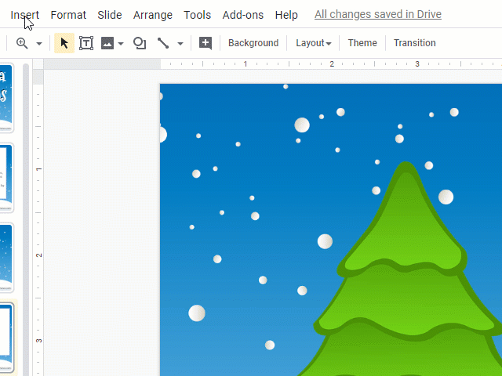
Directions…
You can also create your own ornaments for your tree by using the "Shape" tool in Slides.
Click "Insert" then "Shape".
Choose shapes from the "Shapes" menu or stars from the "Callouts" menu.
After you make your shape you can color it with the "Fill color" button (paint can button).
www.ControlAltAchieve.com - @ericcurts

Slide 4
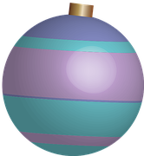
Bulbs

Slide 5
Extras

Slide 6
Write about your holidays…

Slide 7
Write about your holidays…

Slide 8
Write about your holidays…

Slide 9
Write about your holidays…

Slide 10
Write about your holidays…

Slide 11
Write about your holidays…

Slide 12
Write about your holidays…

Slide 13
Write about your holidays…

Slide 14
Write about your holidays…

Slide 15
Write about your holidays…

Slide 16
Write about your holidays…

